Slide 1
Logo animation (intro)

Slide 2


Title slide
Innovolution
the constant in IT is change:
how to make the most of it
Lucas Jellema, CTO Conclusion
Notes:
One of the best parts of working in IT is the ability – perhaps even the necessity – to constantly change.
Adoption of new concepts and new technologies allow us to constantly innovate. This talk is about facilitating that process of innovation – at organization and team level and at a personal level: how do you participate in this constant change? How do you decide which topics to explore when? How do you turn interesting new options into valuable reality? Computer Vision, Blockchain, Generative AI, European Dataspaces, Zero Trust Security, Streaming Data Analysis and Copilot are some examples of technologies and concepts emerged in recent years. How did we deal with them? How did we master them, turn them into propositions and applied them in our projects – or decide not to adopt them? Some successful cases are discussed – as well as some examples of failed innovation. Using the Conclusion Emerging Technologies radar, Lucas will explain how innovation in our ecosysteem of companies takes place – and which roles individual colleagues can play. At the heart of innovation – on a personal level and on a company level – is the eagerness and ability to learn. How do you keep that continuous learning alive?

Slide 3

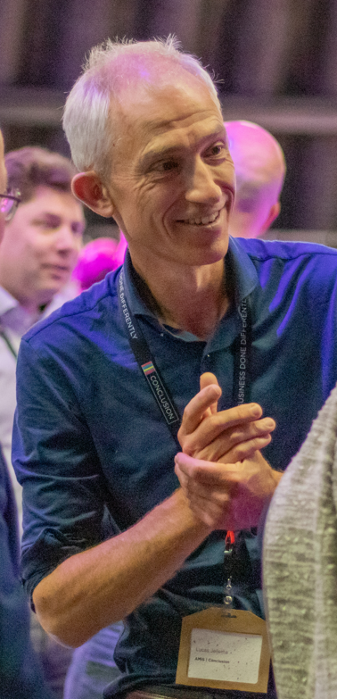
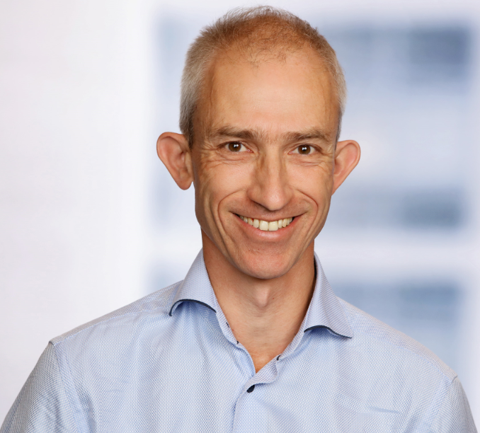
Working with large and small, local and global, startups & scaleups, private & public organisations
2800 colleagues – 20+ nationalities
Founded in 1997 (and 1969, 1991, 2015, …)
Lucas Jellema
Cloud Solution Architect & CTO
Partnering with large vendors and open source projects

Slide 4
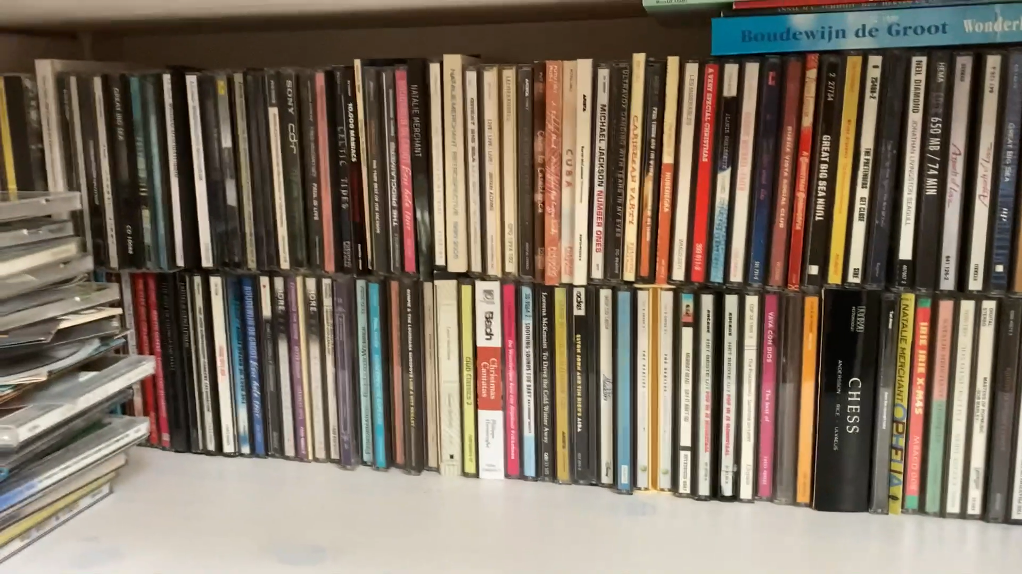

Slide 5

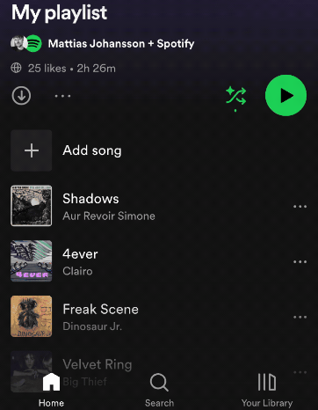

Slide 6
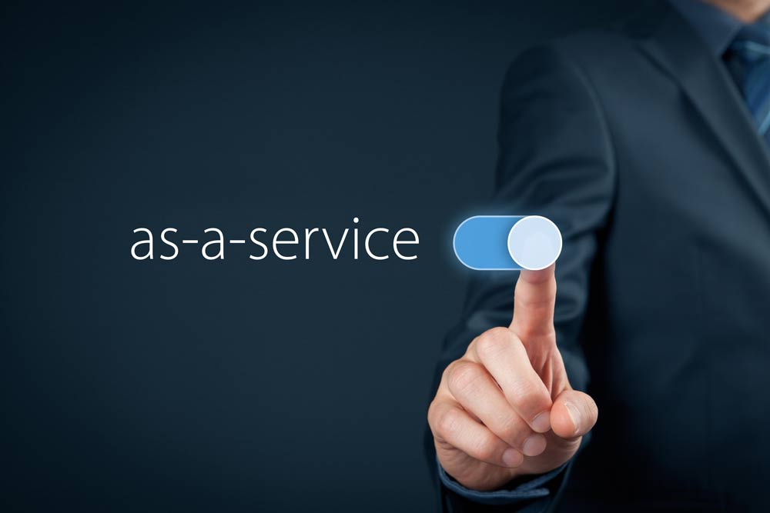
Notes:
we used to have library,
IT has facilitated the deeleconomie

Slide 7


Slide 8
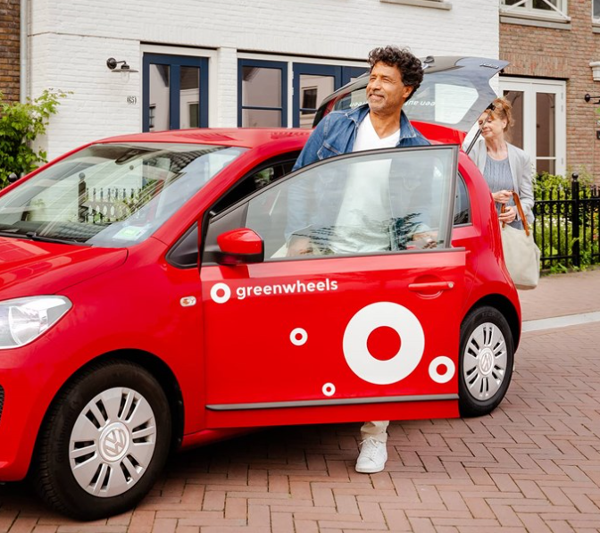
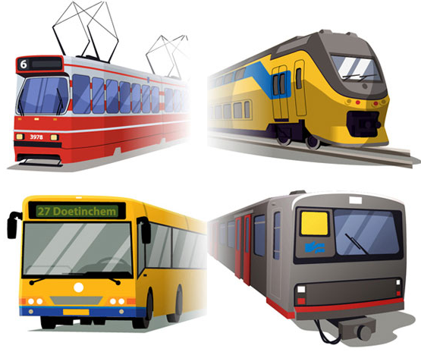
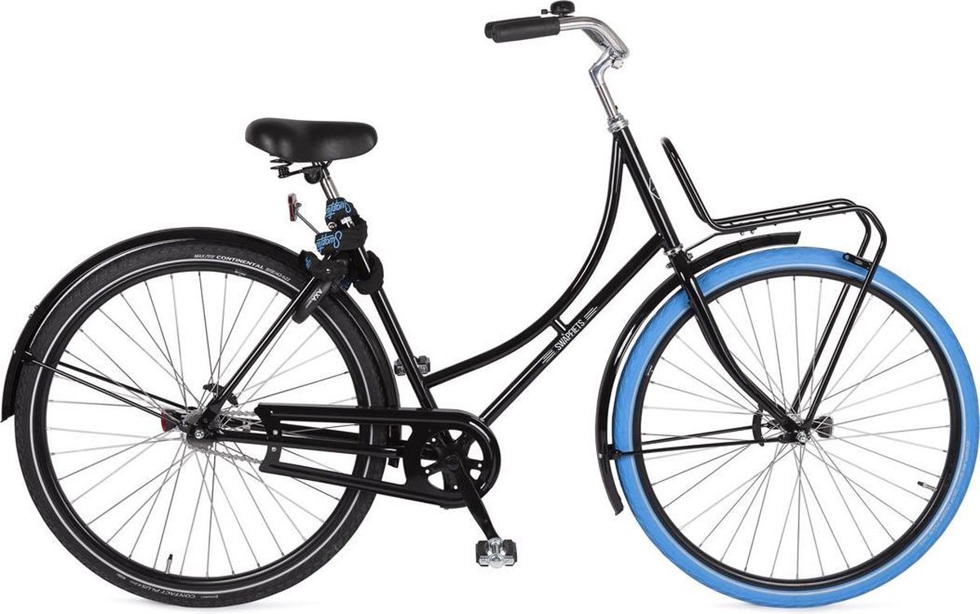

Slide 9
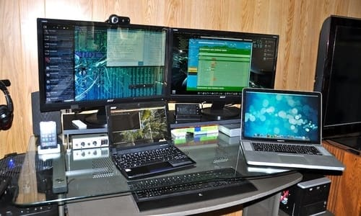

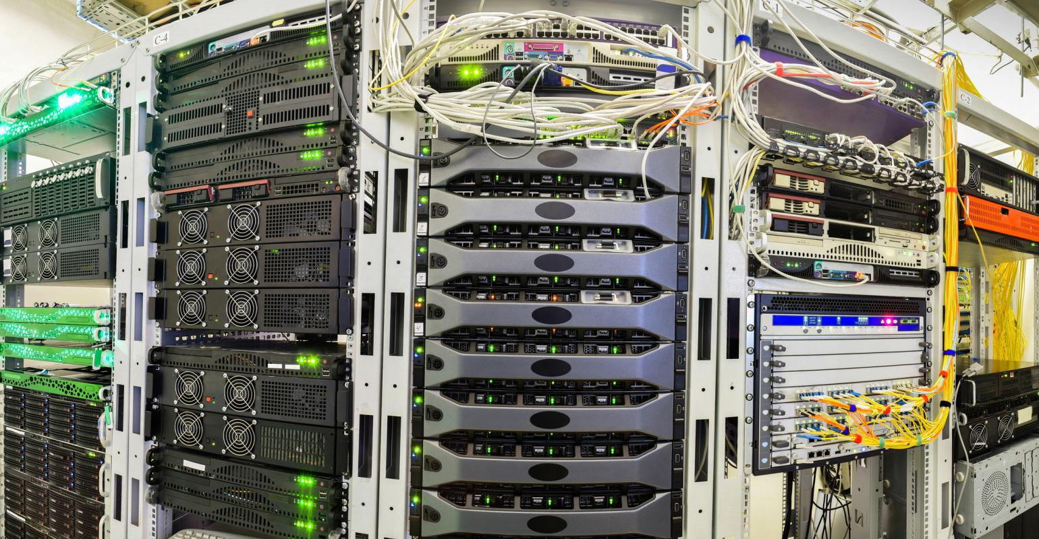

Slide 10
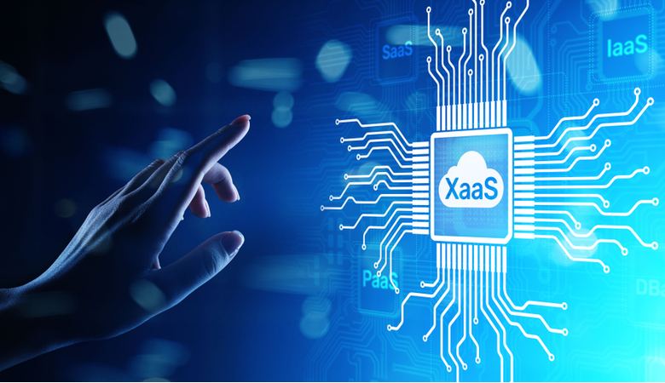

Slide 11
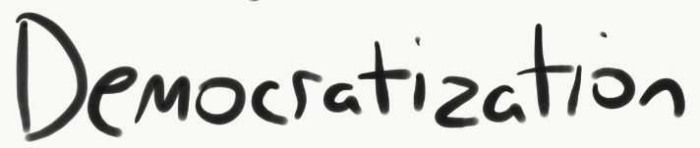
democratization
Notes:
with little money and little expertise – anyone can get going very quickly, pay for use

Slide 12

CAN
WANT
Notes:
stimulating each other
want: ideas/desires
can: opportunities/

Slide 13

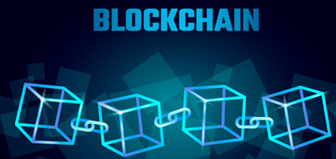
blockchain

Slide 14
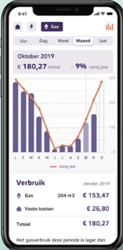

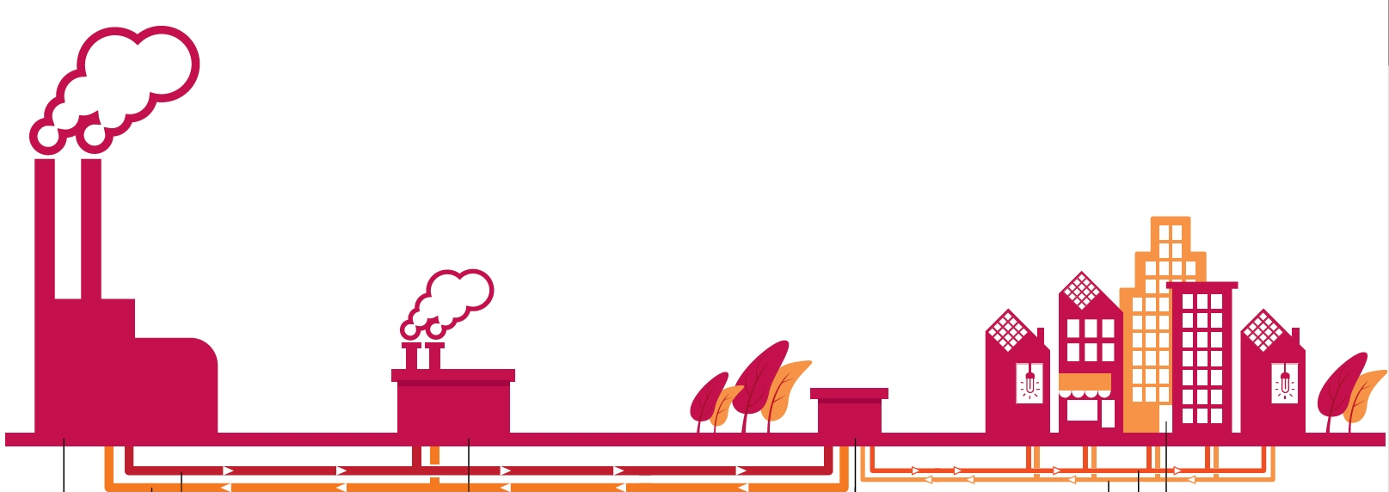


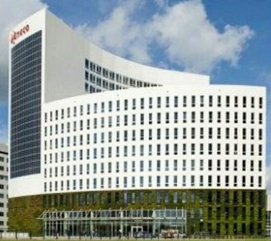
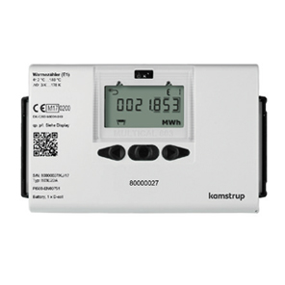

Notes:
EU legislation smart meter – 200K addresses
Business – field engineers (meter opnemers), consumer app, demand prediction and heat production optimization
Technology – IoT, communication (3G,4G, LoRa, Wifi), cloud, agile process/concept of an MVP

Slide 15
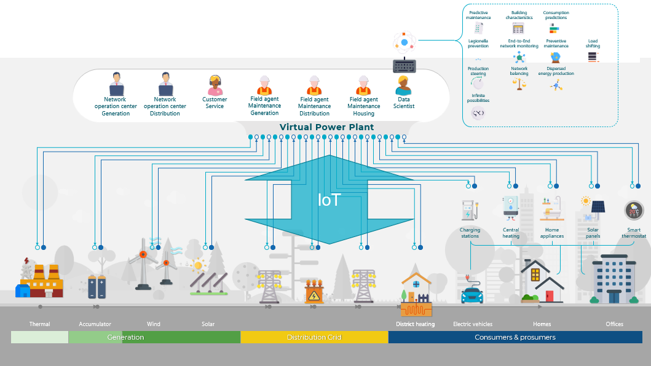

Slide 16

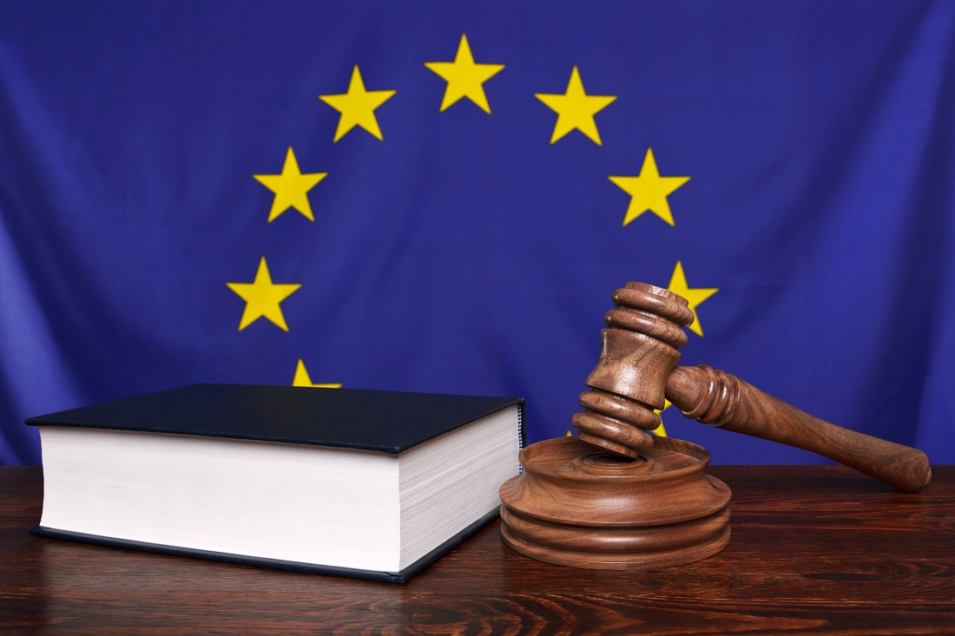


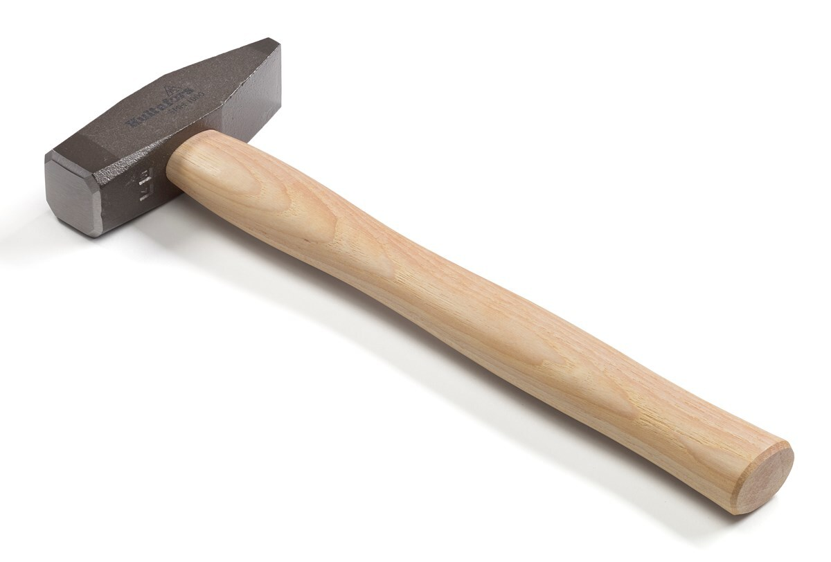


Notes:
ideas, desires, requirements – business, legislation, users
technical possibilities
mindset – open for change
capable to implement change
continuous learning

Slide 17


innovation in IT
Notes:
waterfall => Agile => DevOps (automation, cloud)

Slide 18
IT innovation
Agile
DevOps
Automation
MVP
Canary Release
Notes:
waterfall => Agile => DevOps (automation, cloud)
MVP

Slide 19
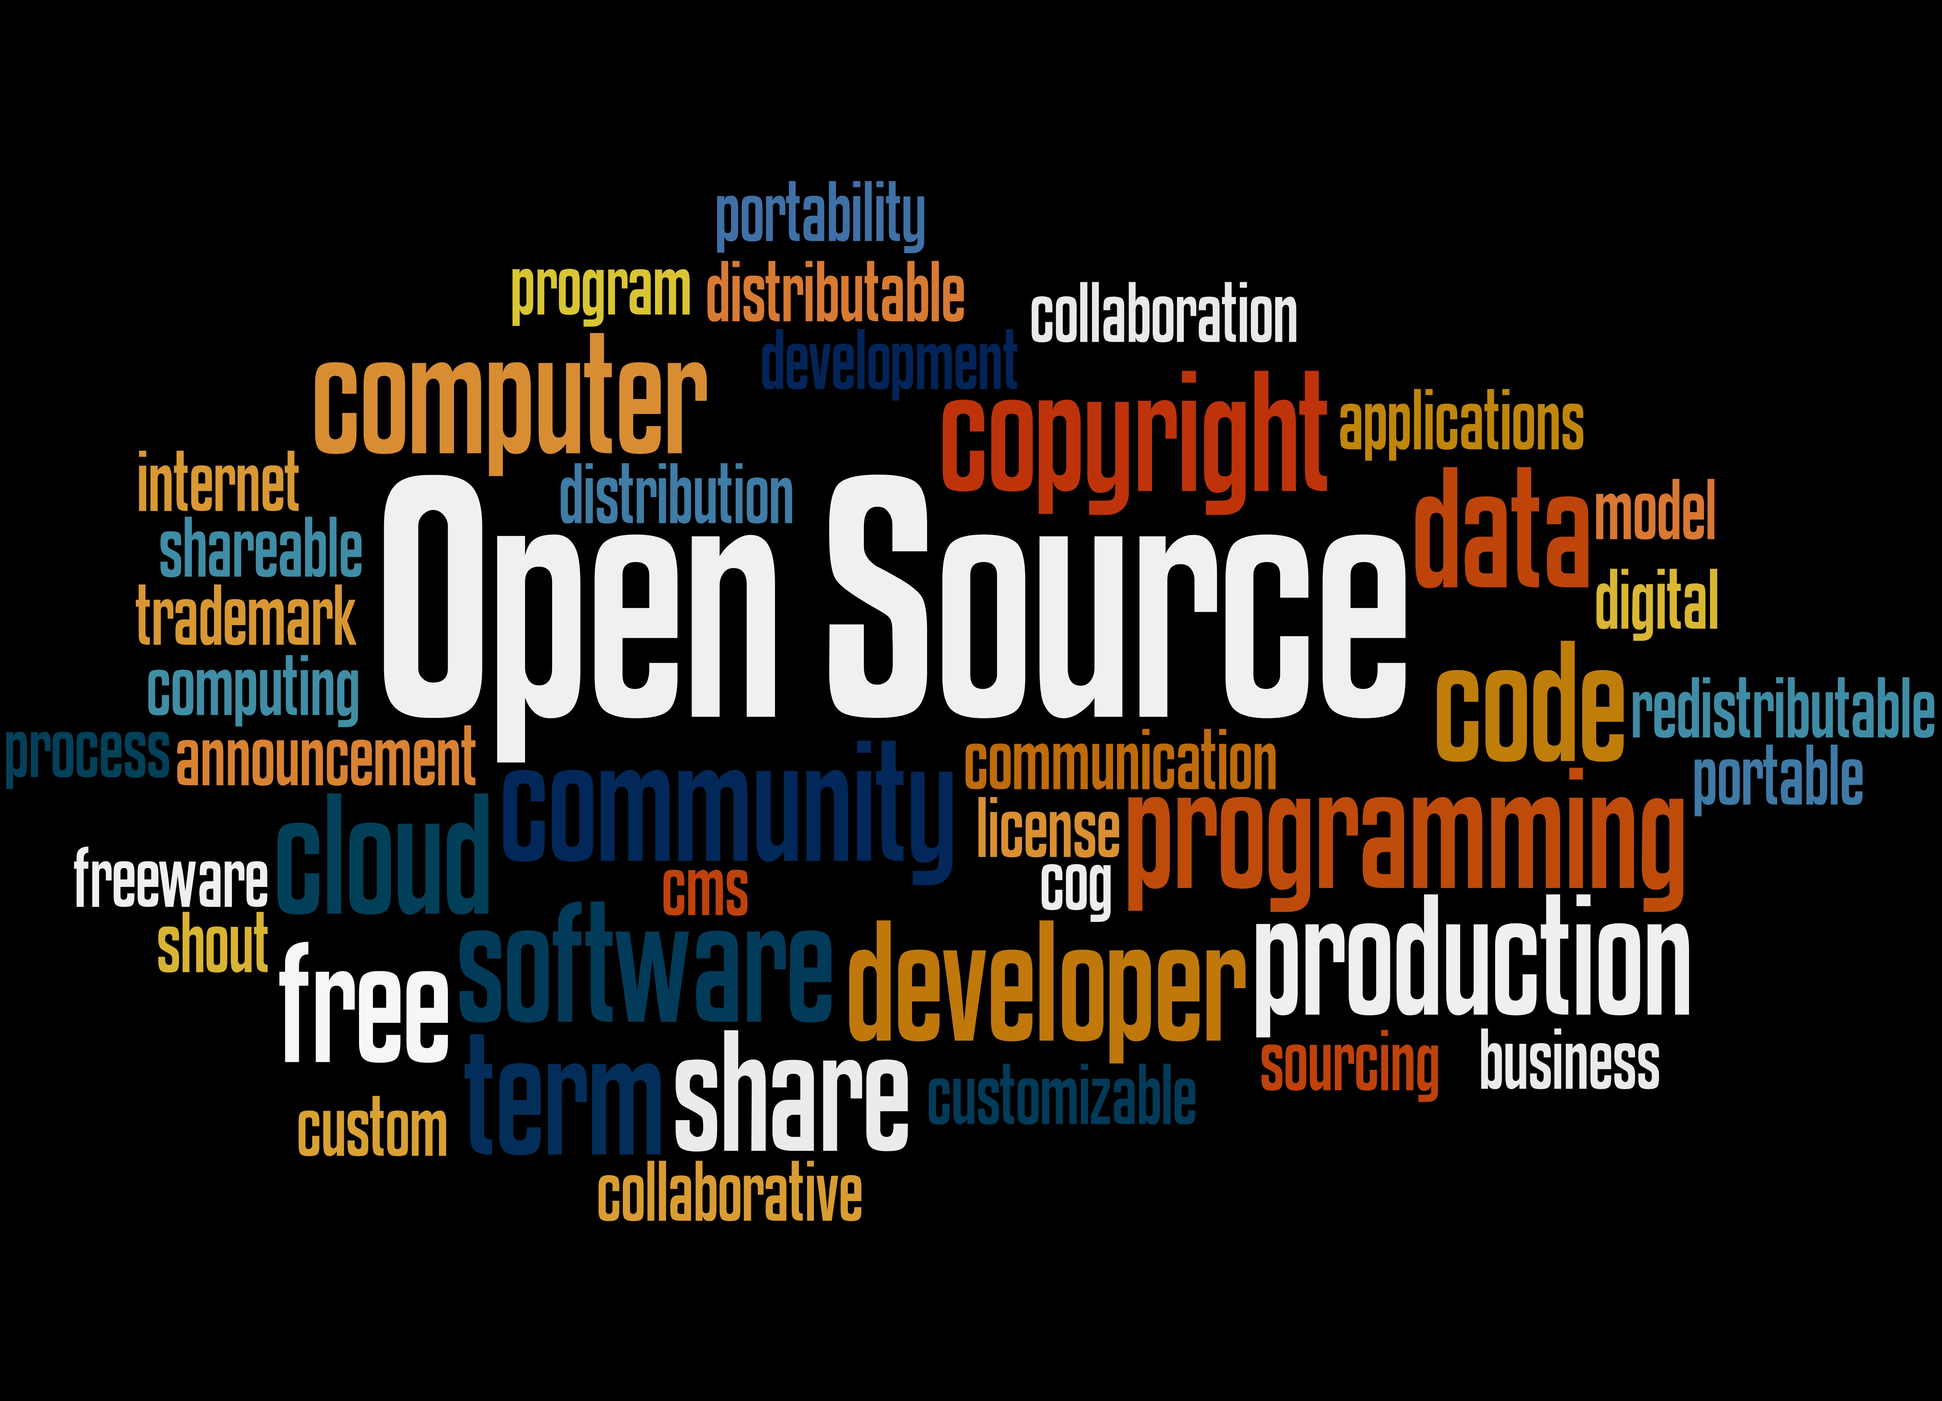
democratization

Slide 20

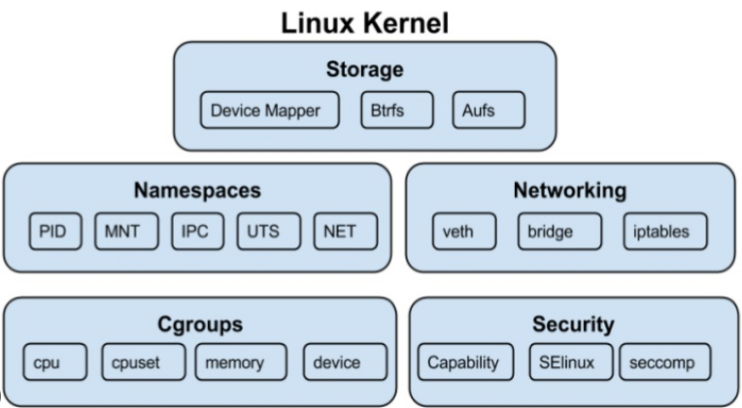


IT Innovation

Slide 21



IT Innovation
Notes:
obscure Linux feature : Namespaces and Control Groups (cgroups)=> Docker => Kubernetes => hardware virtualization, cross machines, locations, clouds

Slide 22

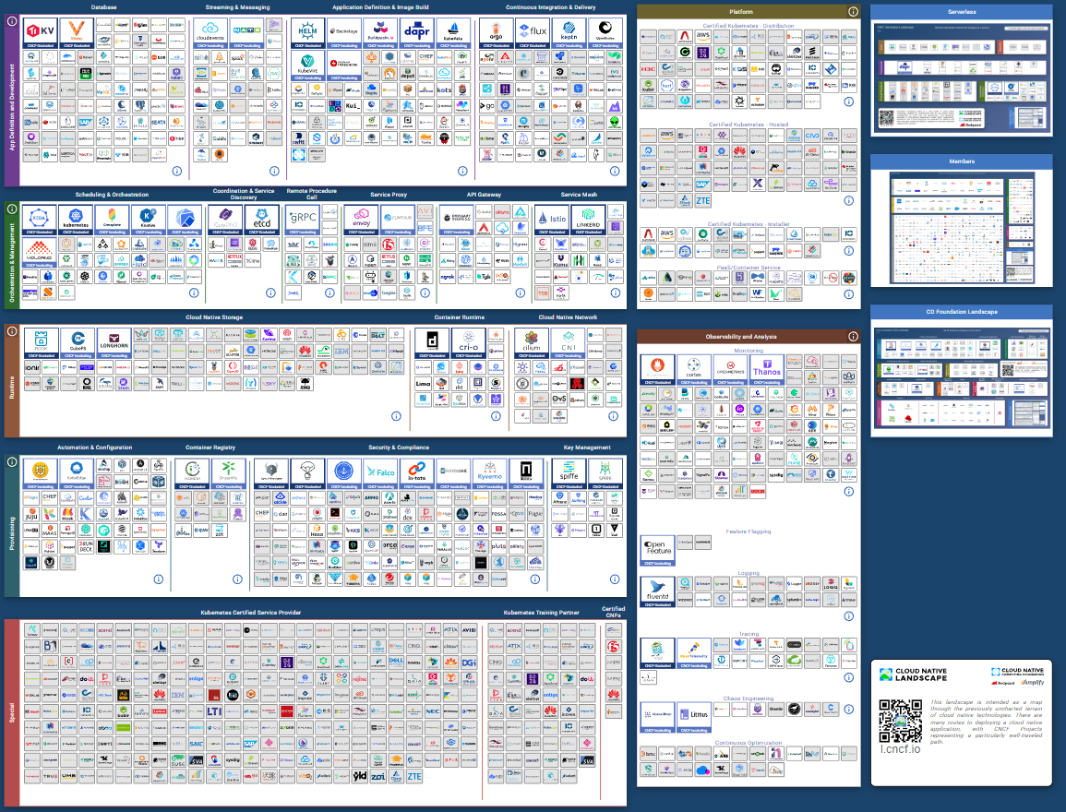
IT Innovation

Slide 23
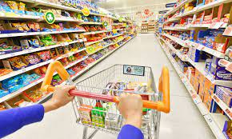
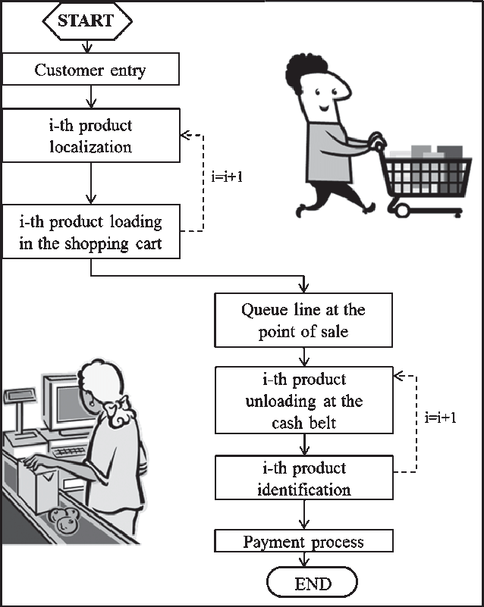
IT’s unique position
Notes:
analyze, structure, abstract, roadmap plan & implement
read ERD and BPM
we can change – design, create, plan

Slide 24
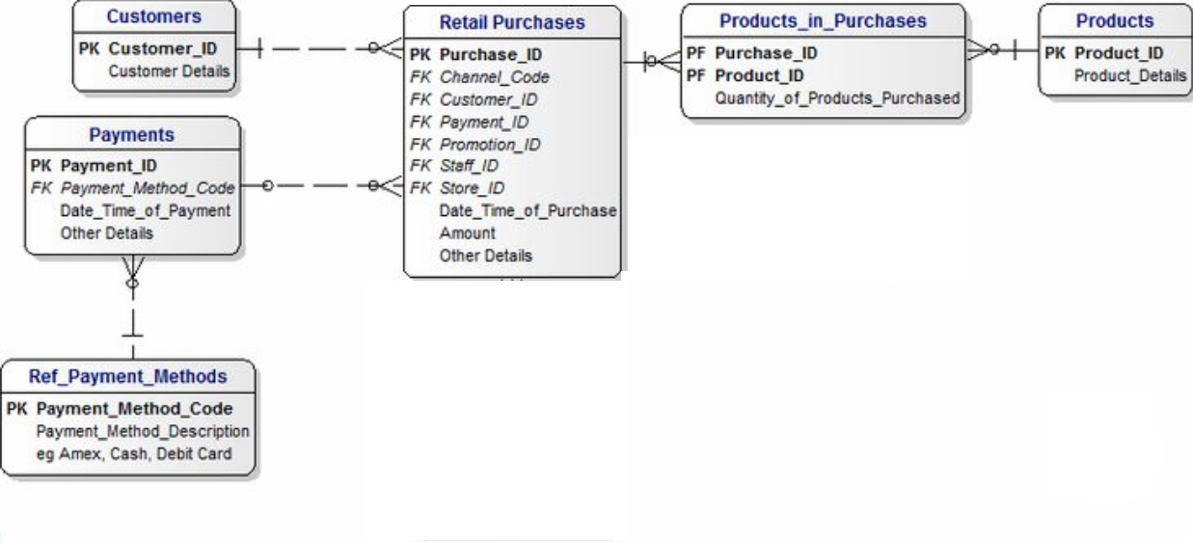

IT’s unique position
Notes:
analyze, structure, abstract, roadmap plan & implement
read ERD and BPM
we can change – design, create, plan

Slide 25
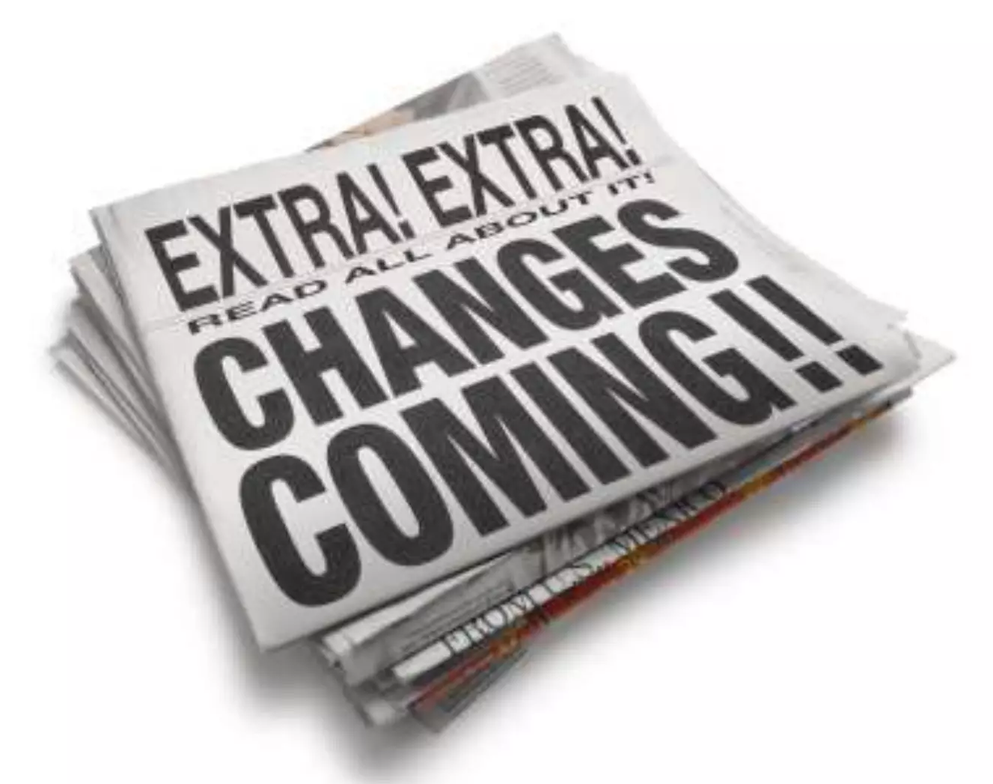
IT == Change
Analyze
Generalize
Structure
Breakdown
Abstract Design
Specialize
Plan & Roadmap
Prototype

Slide 26

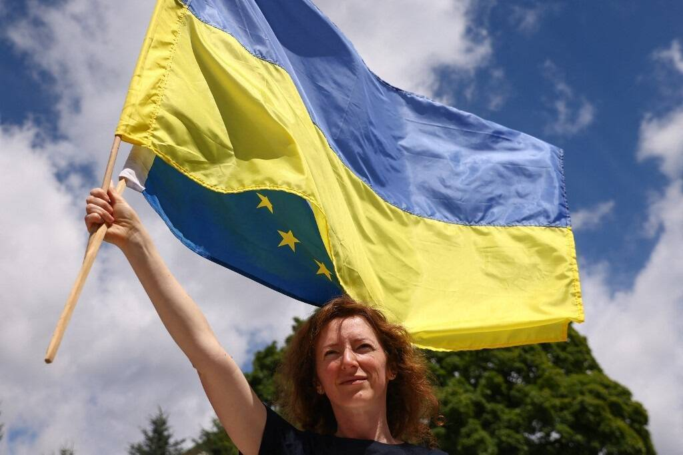


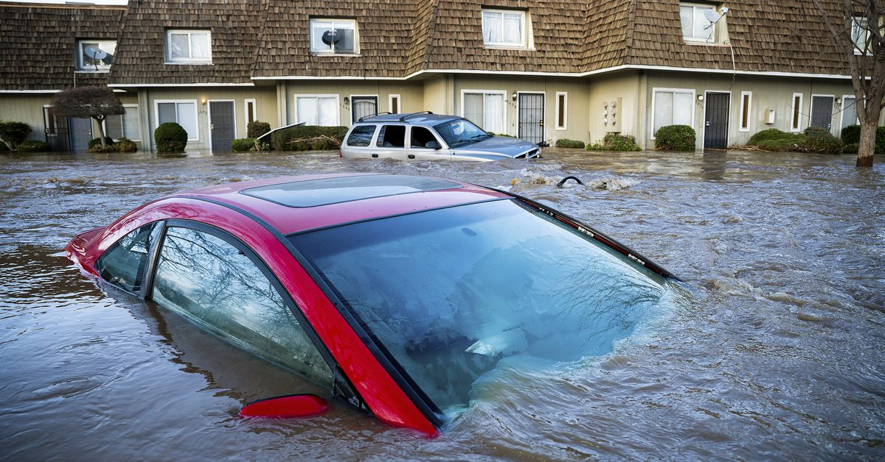
Triggers for change
YOU

Slide 27

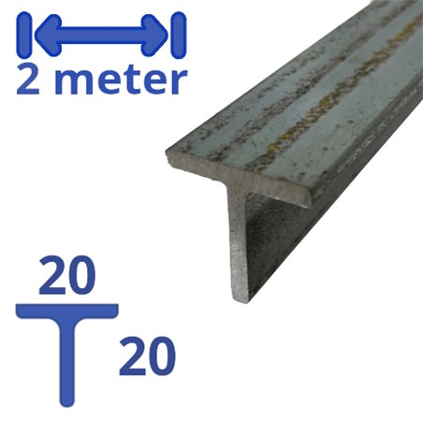
Learn
Explore
Experience
Grow
learn/explore
play
work on that T-shape
be a newbie!

Slide 28
Organization innovation: The Conclusion Ecosysteem

Slide 29





















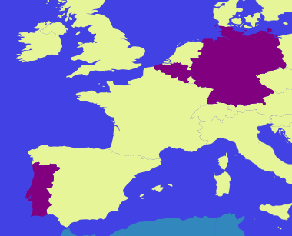

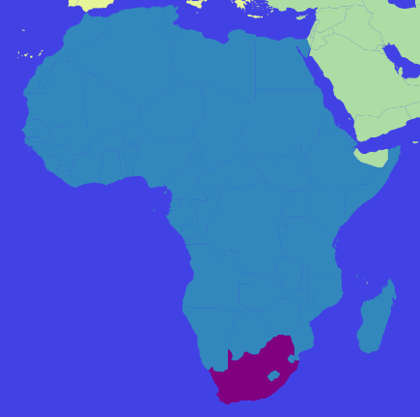

Organization innovation: The Conclusion t-shaped Ecosysteem
Notes:
an ecosystem of autonomous companies that try to find synergy in working together

Slide 30
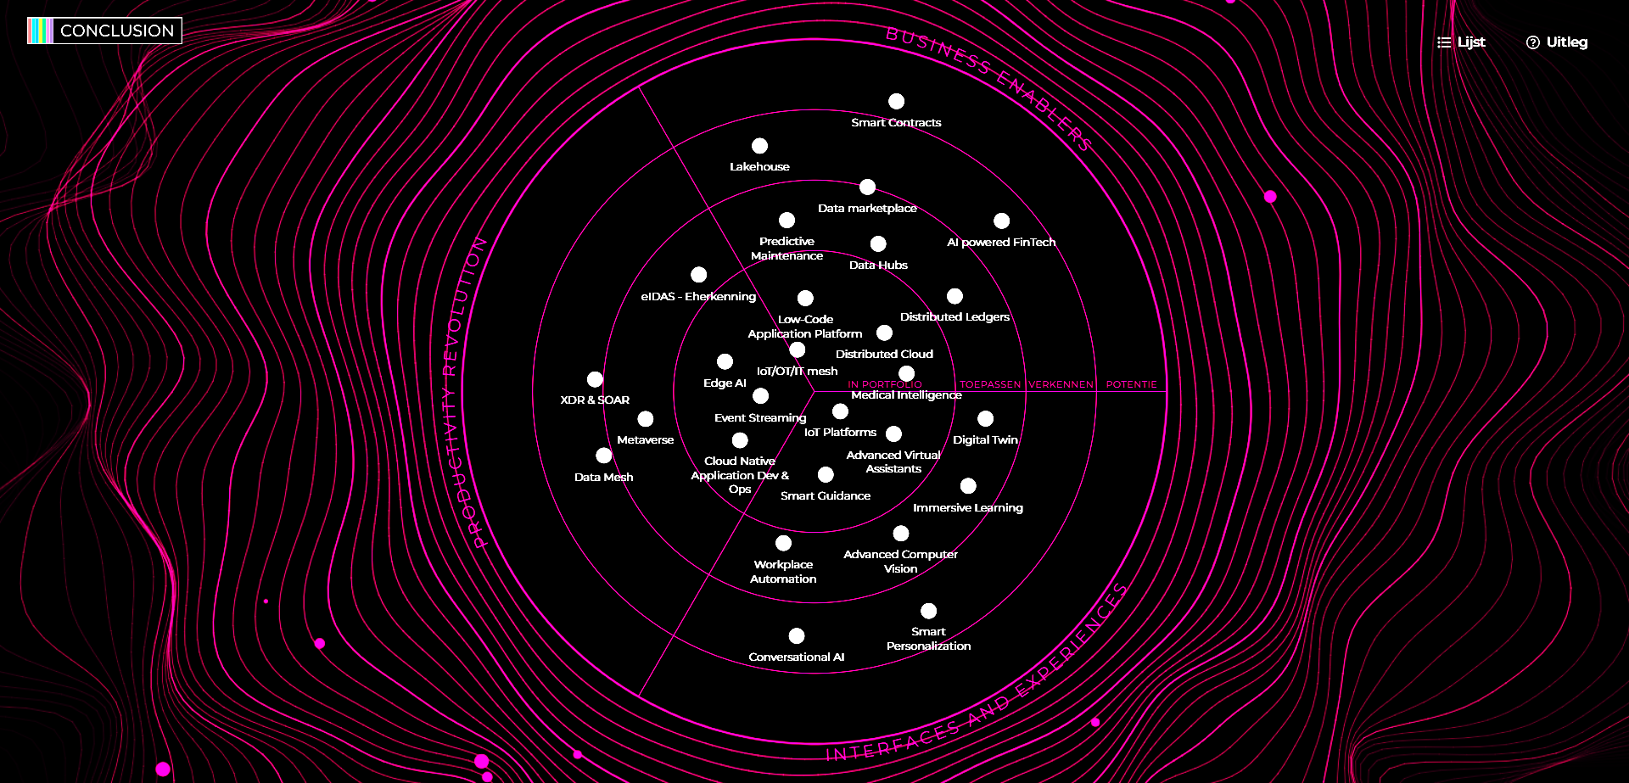
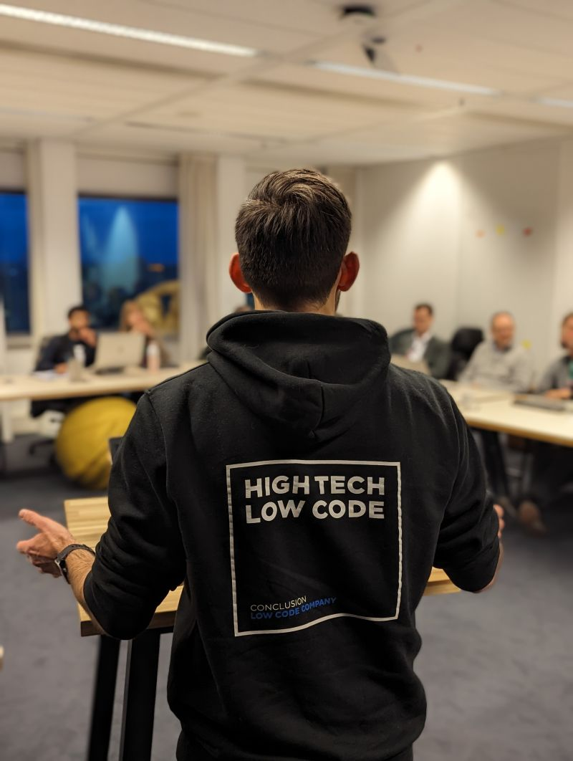

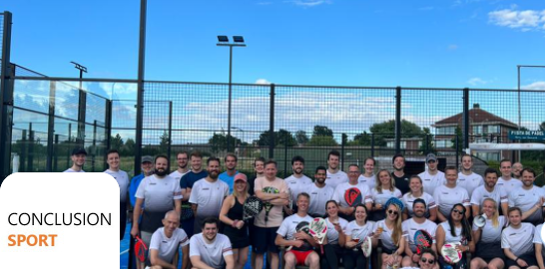
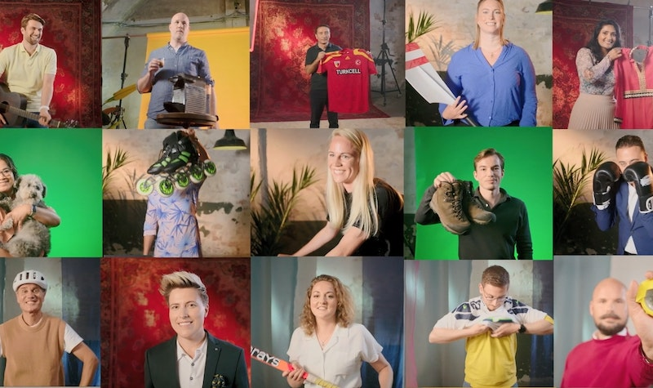



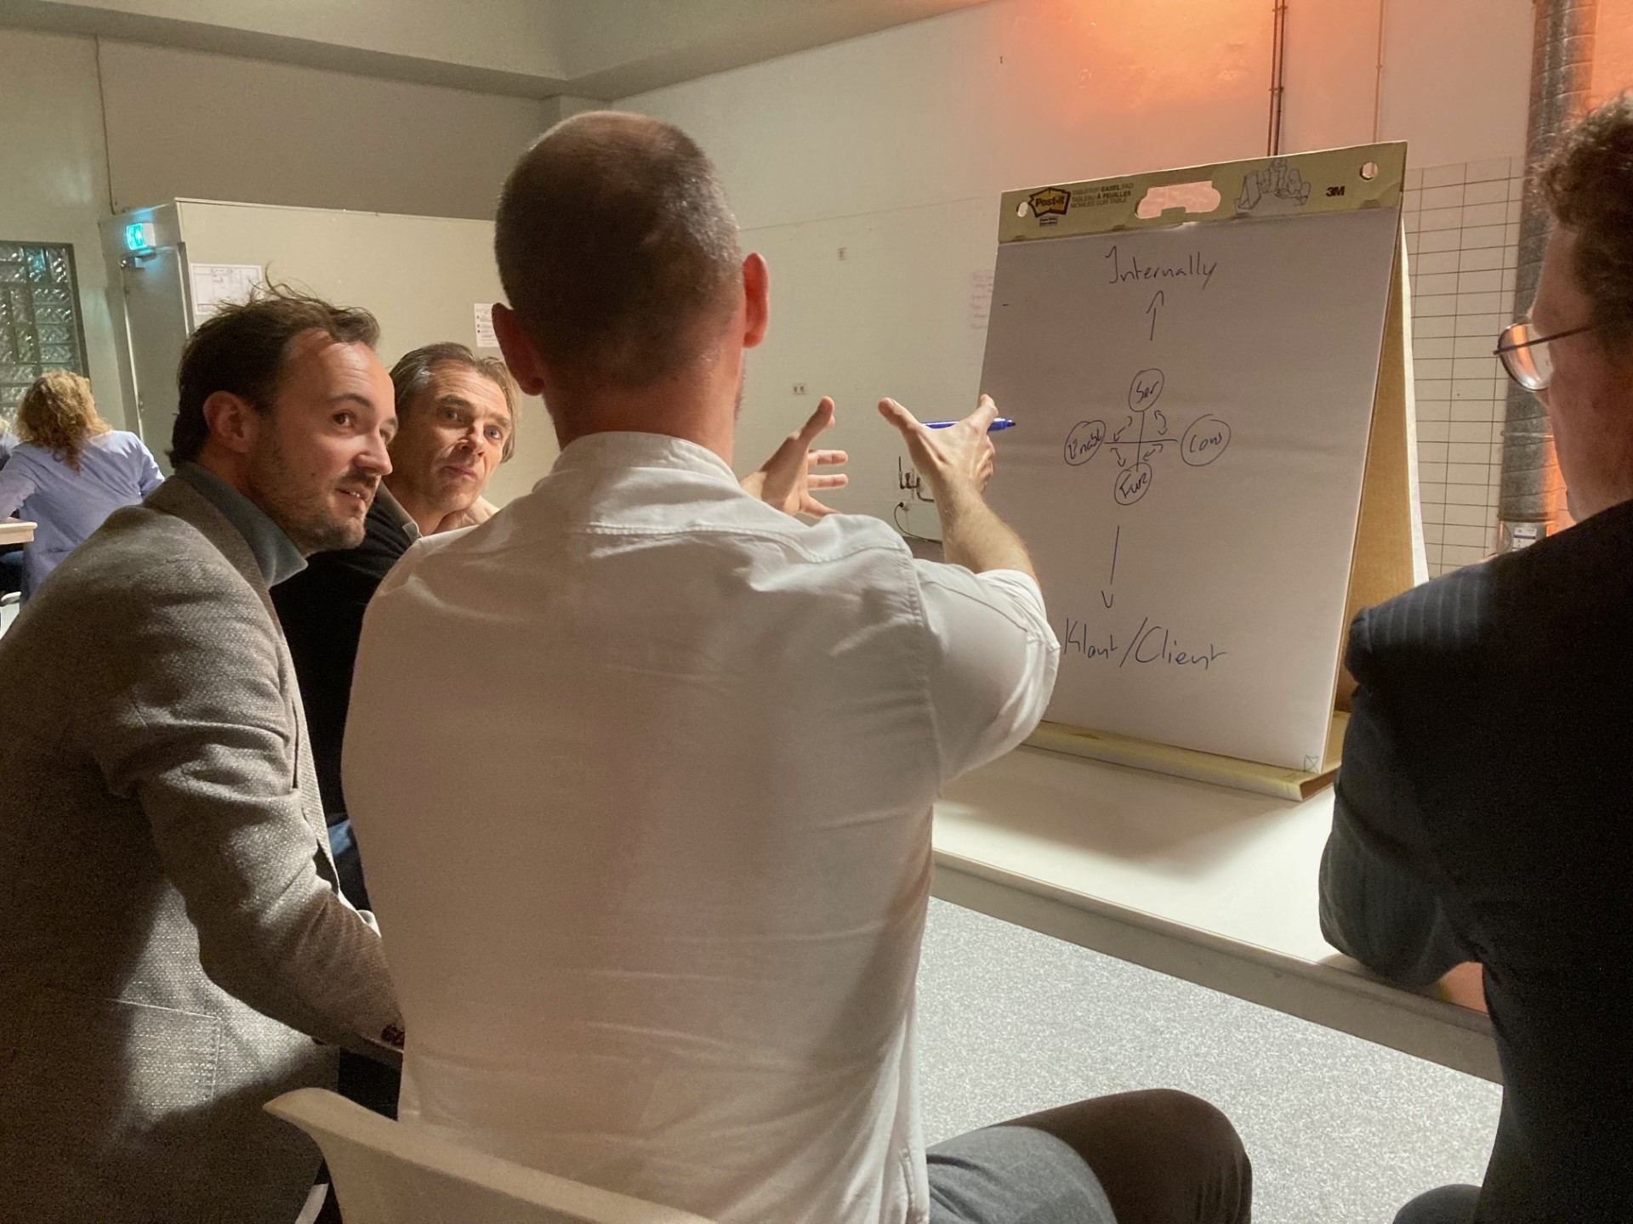
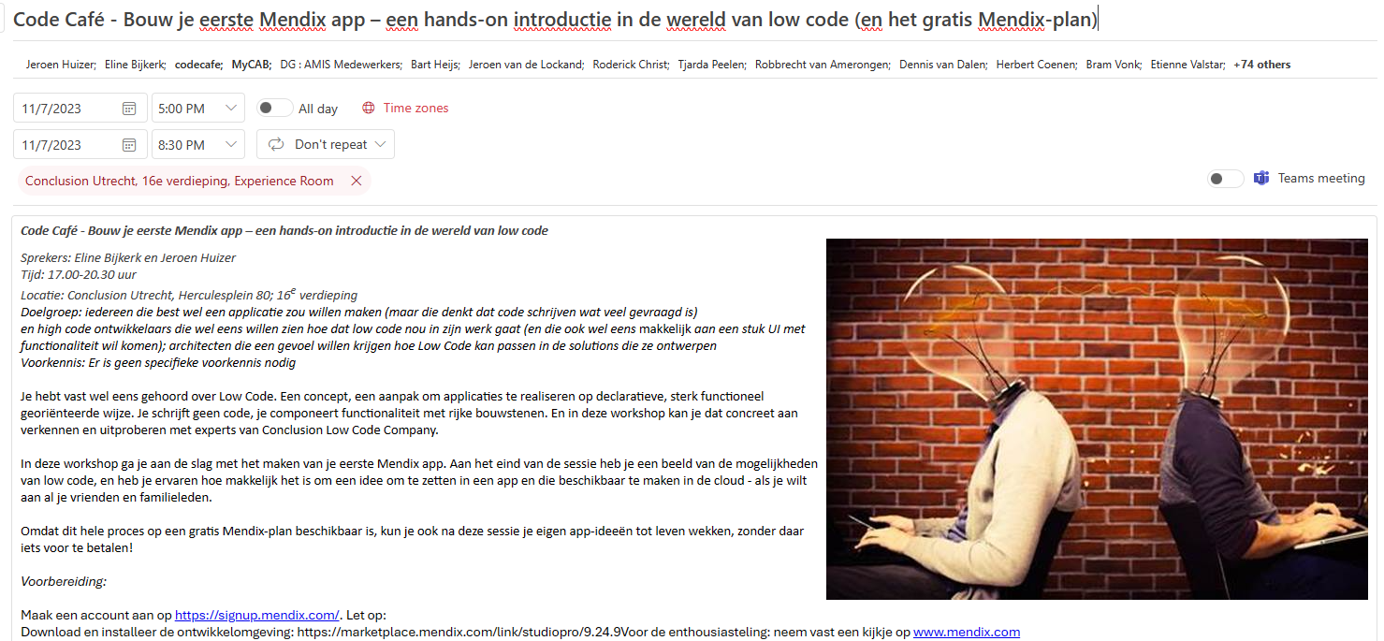
Innovate together
Notes:
Deepen expertise in autonomous companies
Professional Guilds
Code Café
Conclusion Innovate
Sherlock
Internships
Internal Mobility (horizontal career)
Emerging Technology Radar
Conferences
Customer Inspiration Workshops

Slide 31

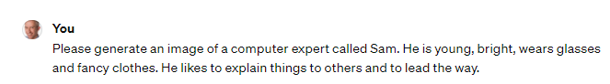

Slide 32


Citizen experience
Notes:
morgens, 4ng, consulting, mediaan, future facts
self service, clearer text, faster and better quality information

Slide 33
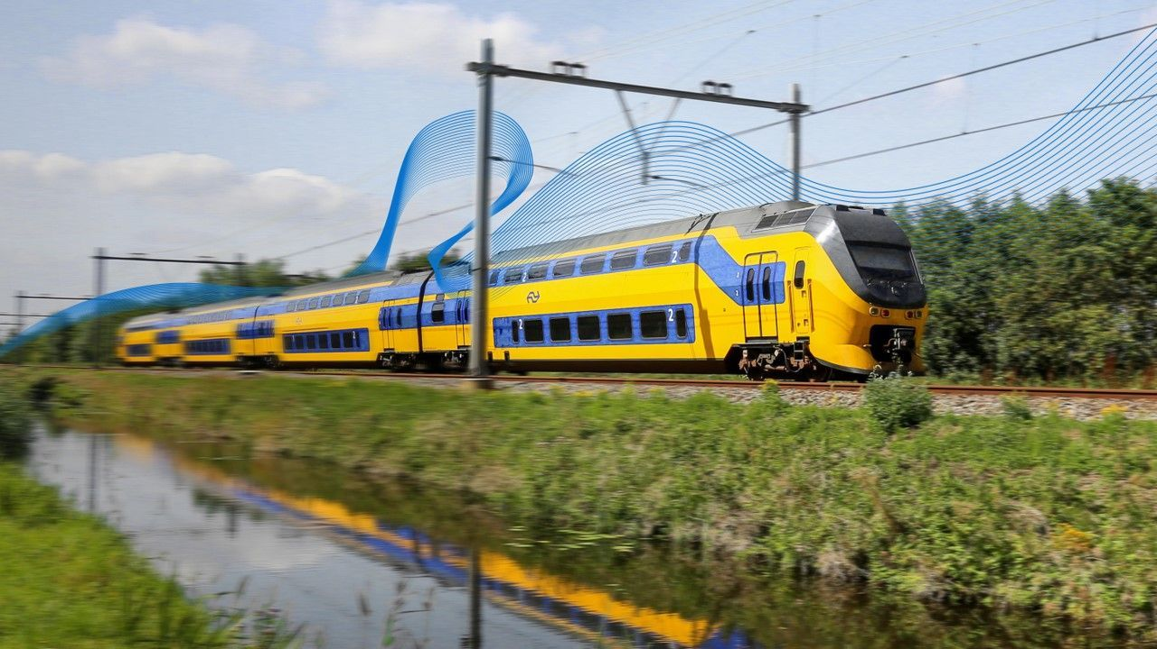
High available integration platform
Notes:
https://tweakers.net/plan/4014/red-hat-variant-skupper-voorop-in-digitale-transformatie-ns.html
integration
H/A
cross applications, cross cloud ⬄ on prem, cross companies, cross clouds
Container, Kubernetes, multi-clusters, Skupper

Slide 34
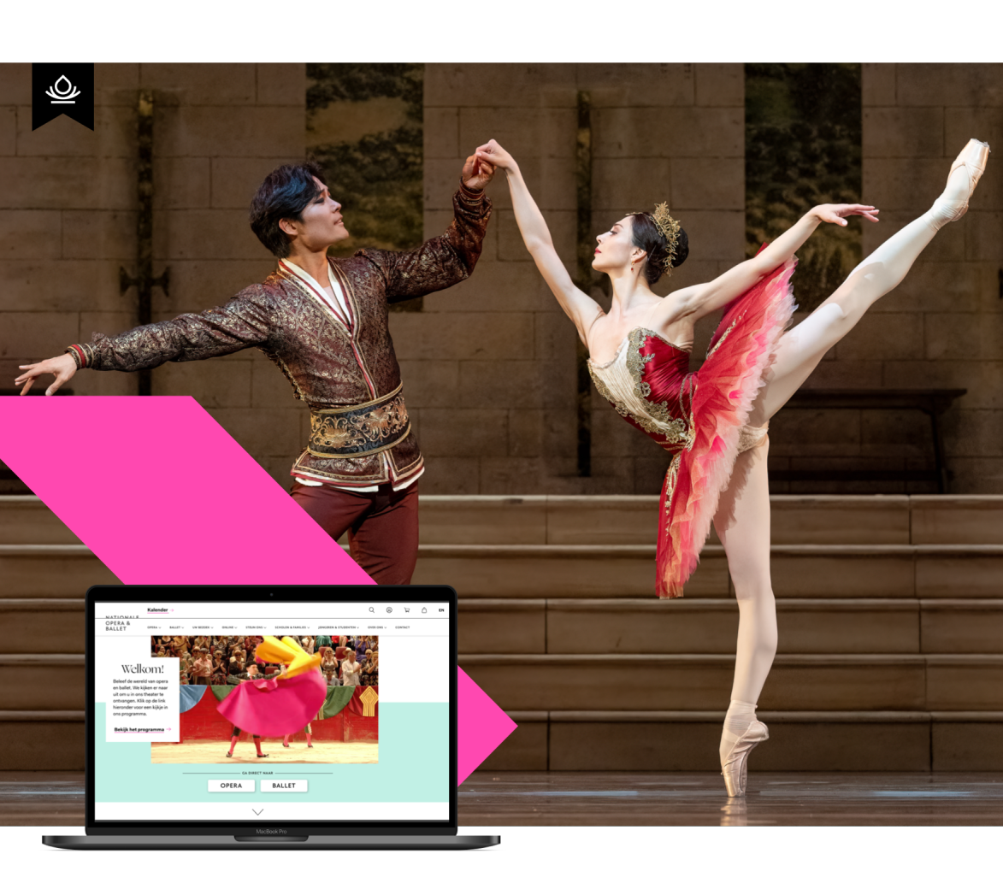
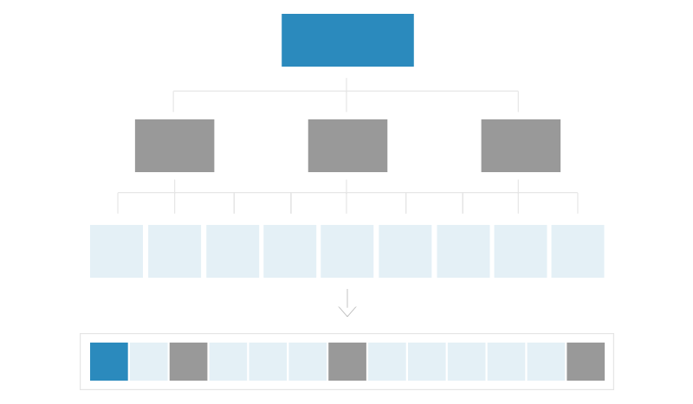
Notes:
National Opera en Baller
Drupal Splash Award in de categorie ‘E-commerce’ gewonnen
Online ticketverkoop met 23% gestegen
Conversie op mobiele apparaten met 11,5% gestegen
Intensieve interdisciplinaire samenwerking in een complex IT landschap
samenwerking + integratie
de koppeling met het ticketingsysteem
Wij werken sinds een jaar met een nieuwe verlofregeling, wat inhoudt dat onze collega's gebruik mogen maken van onbeperkt verlof. We werken samen op basis van vertrouwen, collega's zijn zelf verantwoordelijk voor hun planning en financiële omzet die ze jaarlijks moeten behalen op basis van salaris en rolniveau. Daarnaast is het nodig om met je omgeving af te stemmen of het past uiteraard. Het minimum aan aantal vakantiedagen wat we hanteren is 25, zoals we voorheen ook in onze arbeidsovereenkomst hadden staan en aanvullend is iedereen dus vrij om meer dagen op te nemen (rekeninghoudend met eerder genoemde richtlijnen).

Slide 35
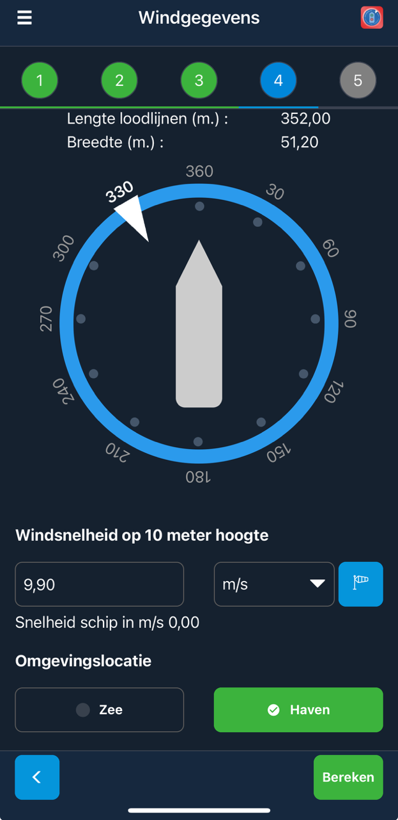
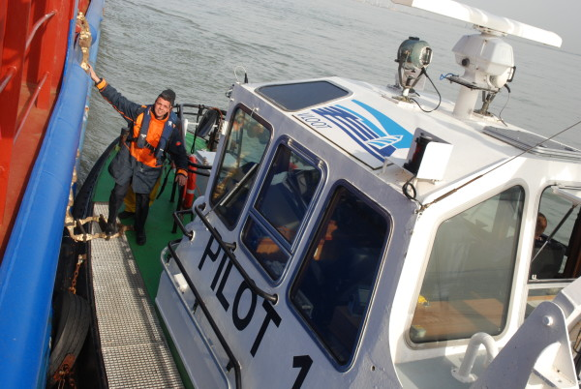
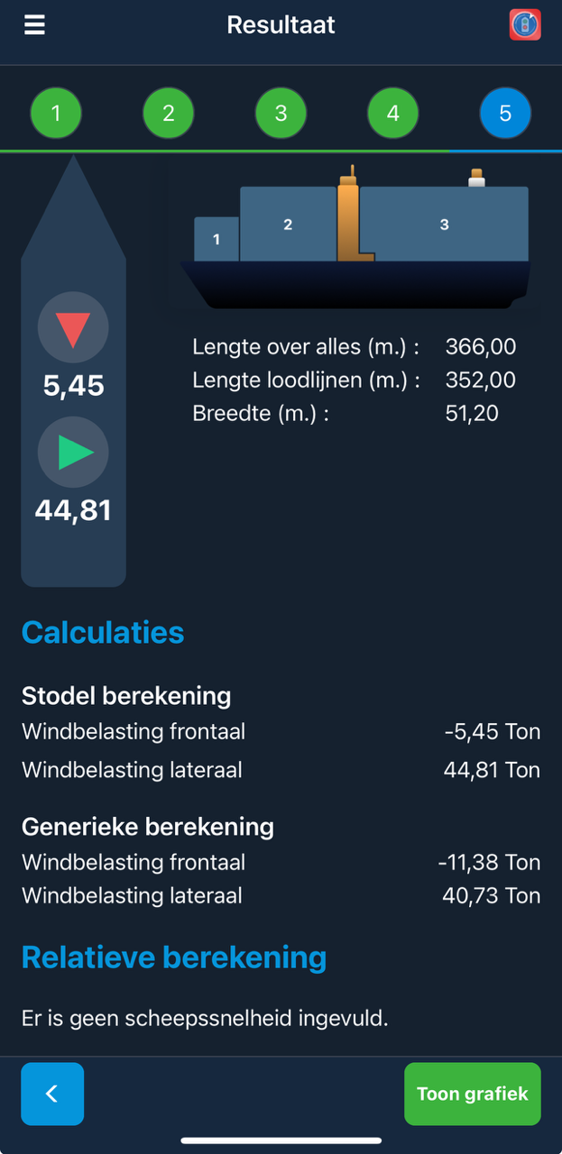
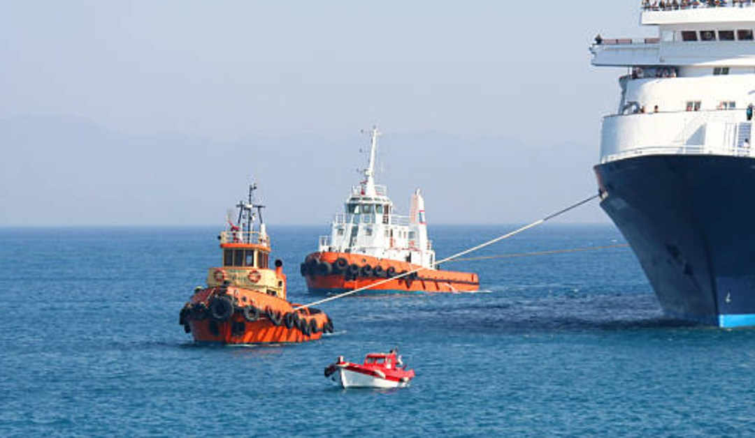

Het loodswezen
Notes:
https://www.conclusion.nl/low-code-company/cases/samen-wachten-bij-gemeente-rotterdam
kiosk, Android webapp, Mendix; integrated with queuing system

Slide 36
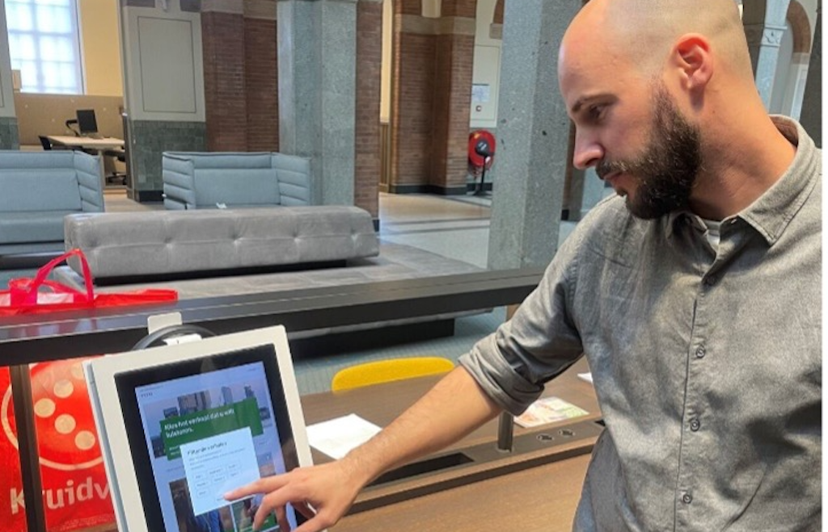
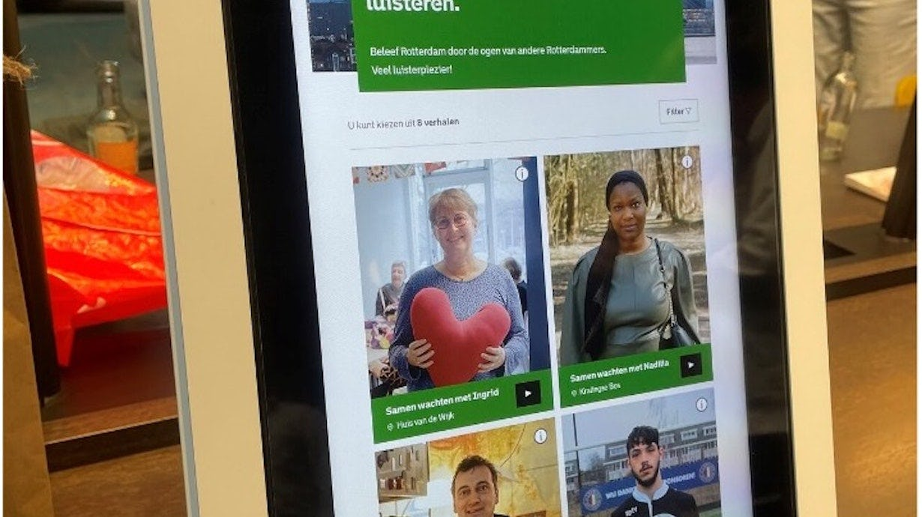
“Waiting together” – Gemeente Rotterdam
Notes:
https://www.conclusion.nl/low-code-company/cases/samen-wachten-bij-gemeente-rotterdam
kiosk, Android webapp, Mendix; integrated with queuing system

Slide 37
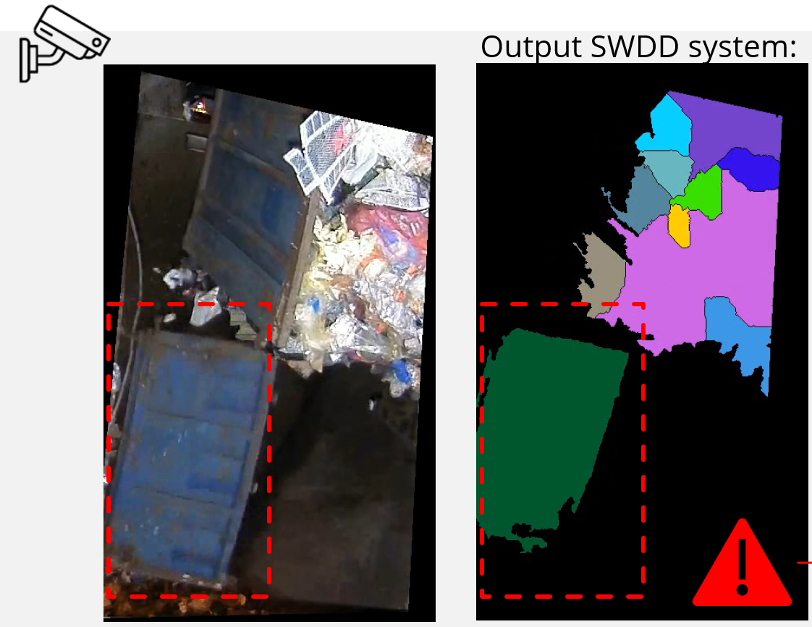



clean computer vision
Output SWDD system:
Warning!
Large object in dump hole 4!

Slide 38

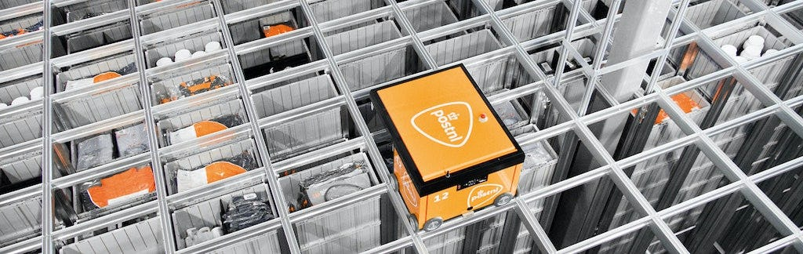



Collect data, provide insight, improve forward

Slide 39




Slide 40


Global mitigation potential atlas
Notes:
Dubai, Climate Capital of the world
COP28
Ecosystem thinking and acting between countries
joined force with Consortium: Climate Analytics, gov Indonesia, Singapore and The Netherlands
share data and case studies on CO2e emission mitigation potential – especially on benefits of collaboration
most reduction for $

Slide 41


Slide 42
leading trends
next iteration in browser technologies, Kubernetes, Jupyter Notebooks, Java/.Net/Go/Rust, native images, interoperability between programming languages
Generative AI, AI Agents, Custom Data, spoken conversation
Automation, IT4IT, Developer Portal
Meta verse
aaS
DevOps
Modernizing legacy IT (and processes)
Labor market scarcity in professionals
5G NFC, LoRa
Security
Cloud – European, Multi-Cloud, Hybrid
European Dataspaces and personal data ownership
Generative AI, AI Agents, Custom Data, spoken conversation
Sustainability
European and Dutch Legislation
Computer Vision
Requirements Engineering
Machine Customers
Notes:
next iteration in browser technologies, Kubernetes, Jupyter Notebooks, Java/.Net/Go/Rust, native images, interoperability between programming languages

Slide 43


Dare to be that little girl

Slide 44

Innovolution
What you can do drives what you want to do, which spurs on what you can do and inspires what you want
IT == Change
Innovation = technology + idea + mindset + process
Continuous Exposure – Learn & Play deep and broad
Talk to strangers …

Slide 45


Logo
www.conclusion.nl
lucas.jellema@conclusion.nl | technology.amis.nl | @lucasjellema | lucas-jellema

